Slide 1


PROJECT PRESENTATION
Tracking System
BY
1.INDERJOT KAUR BHAMBRA 326257
2.SHAIK FAREEDA MEENAZ 325833
3.AKASH PADHAN 325577
4.DEVI VARA PRASAD KADA 325837

Slide 2

INTRODUCTION:
XYZ Solutions provides automation of scheduling interviews for candidates.
The interview and hiring process in the company is quite huge and involves lot of people.
So a centralized system is required to keep track of the interview process.

Slide 3




Users:
ADMIN
TECH PANEL
HR PANEL

Slide 4
AIM OF THE PROJECT:
Priority 1:
1.All users (Administrator, Tech & HR) logging into the ITS application should be authenticated using a unique login-id and password.
2. The application should handle logout (close all open database connections, invalidate sessions, etc)
3. The administrator should be able to add candidate information
4. The administrator should be able to search candidate based on skills, experience and qualification
5. The administrator should be able to share candidate information to Tech and HR panel

Slide 5
AIM OF THE PROJECT:
Priority 1:(Contd…)
6. The administrator should be able to schedule interview for suitable candidates by selecting Tech panel
7. The administrator should be able to schedule interview for tech cleared candidates to HR panel
8. The administrator should be able to make final decision on ratings given by HR panel
9. The Tech panel should be able to view his/her members to be interviewed
10. The Tech panel should be able to submit his/her interview feedback with ratings

Slide 6
AIM OF THE PROJECT:
Priority 1:(Contd…)
11. The HR panel should be able to view his/her members to be interviewed.
12. The HR panel should be able to submit his/her interview feedback with ratings.
All users should be able to change their password.
The administrator should be able to view candidate’s ratings given by both Tech and HR panel.
3. The administrator should be able to declare candidate results to both Tech and HR panel .
4. The Tech panel should be able to view final results declared by administrator.
5. The HR panel should be able to view final results declared by administrator.
Priority 2:

Slide 7
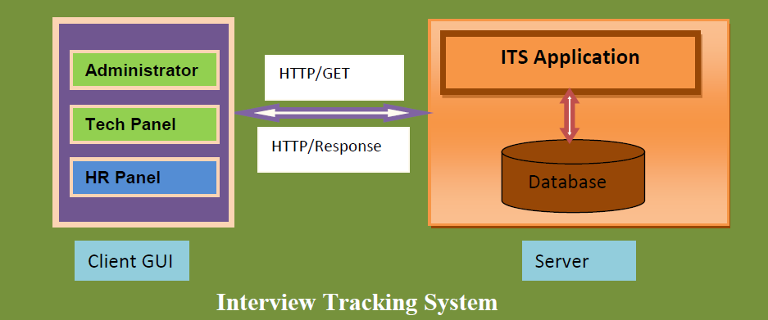
FUNCTIONAL FLOW:

Slide 8
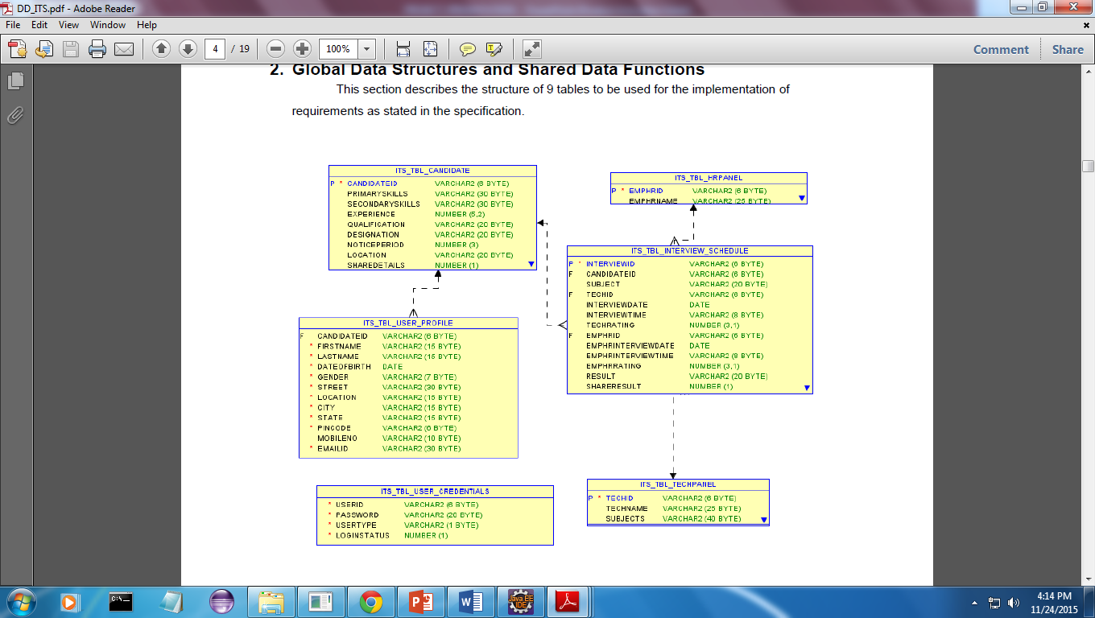
DATABASE DESIGN:

Slide 9
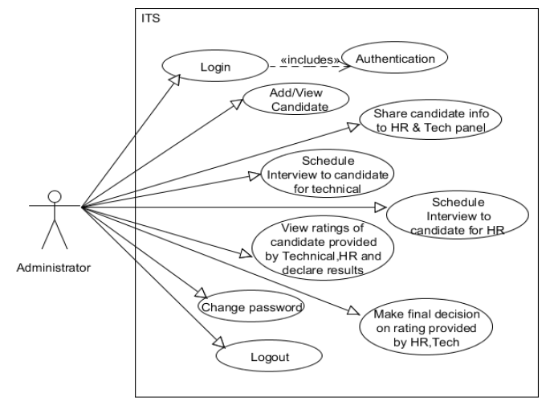
ADMIN:

Slide 10
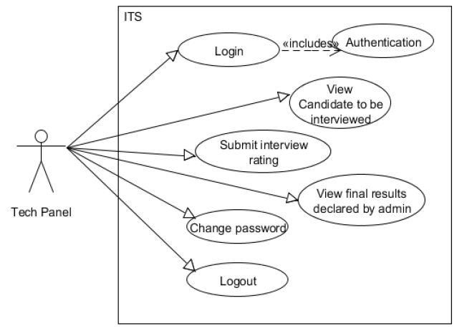
TECH PANEL:

Slide 11
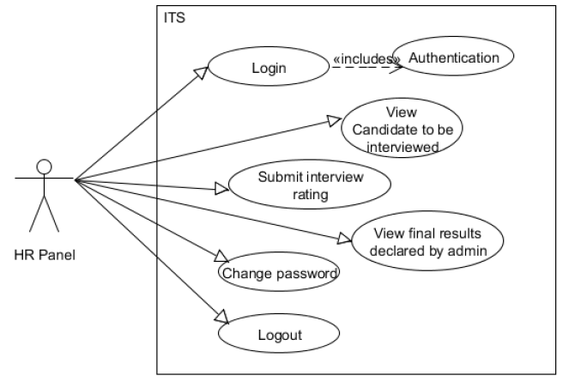
HR PANEL:

Slide 12
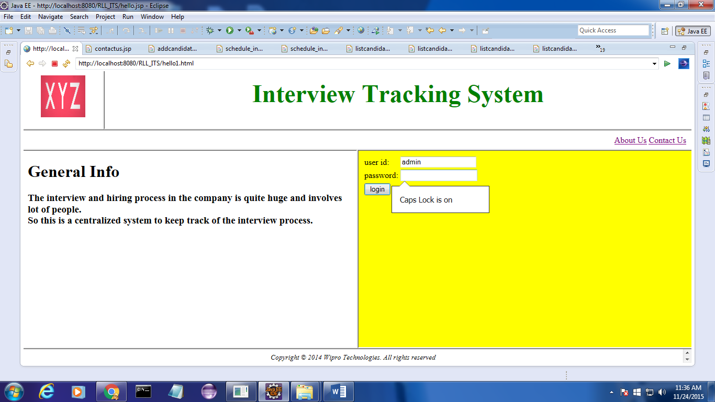
LOGIN:

Slide 13
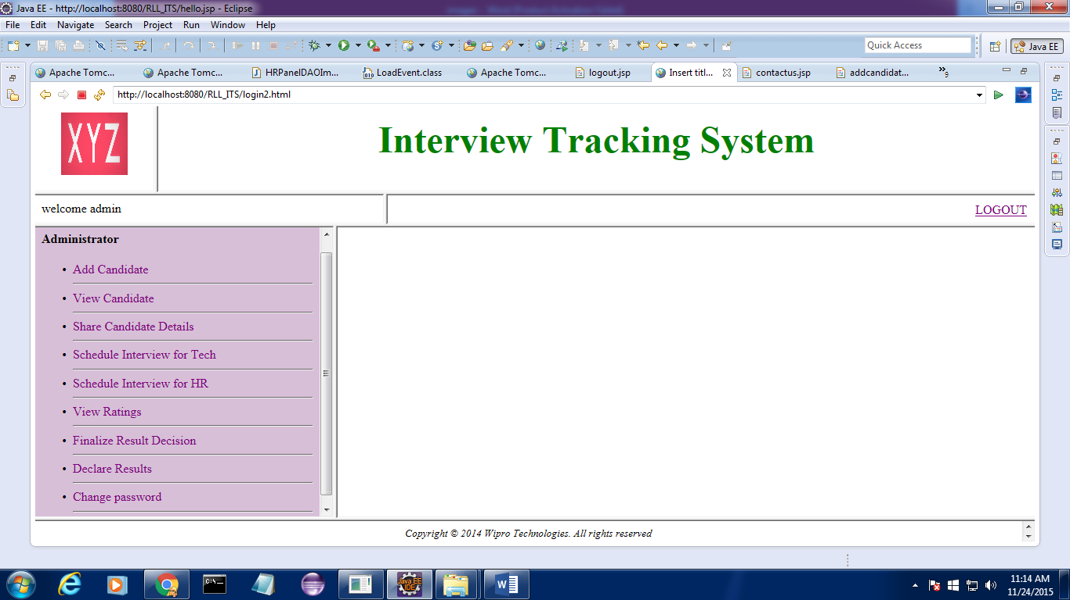
LOGOUT:
LOGOUT

Slide 14
ADMIN:

Slide 15
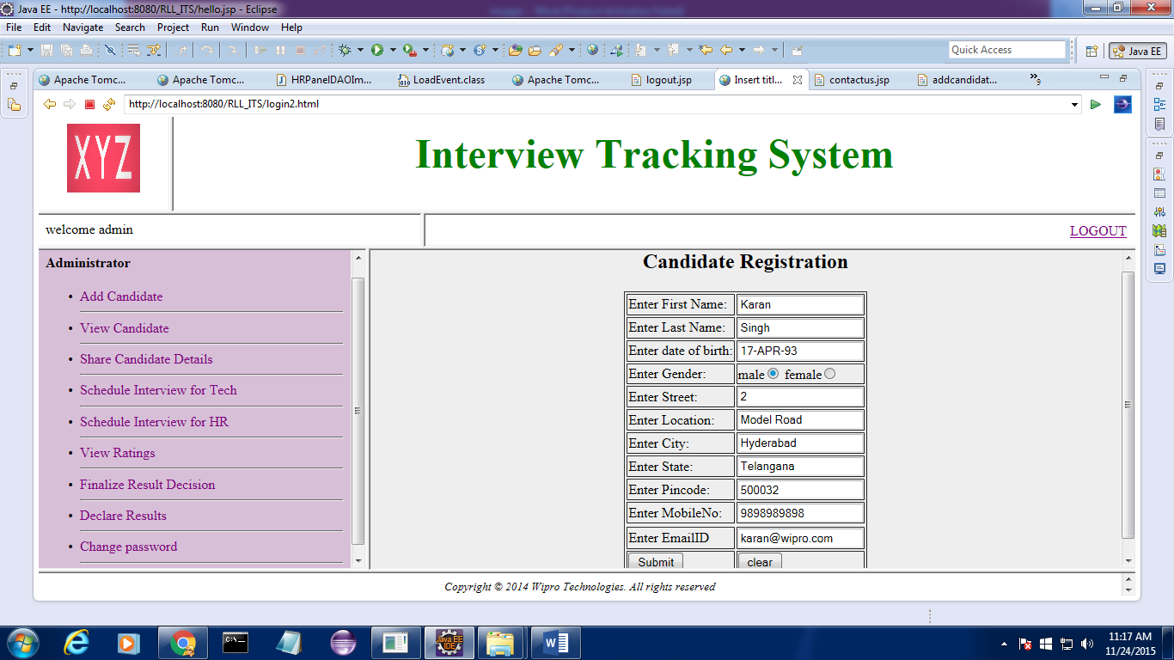
ADD CANDIDATE INFORMATION:
ADD ENTRY

Slide 16
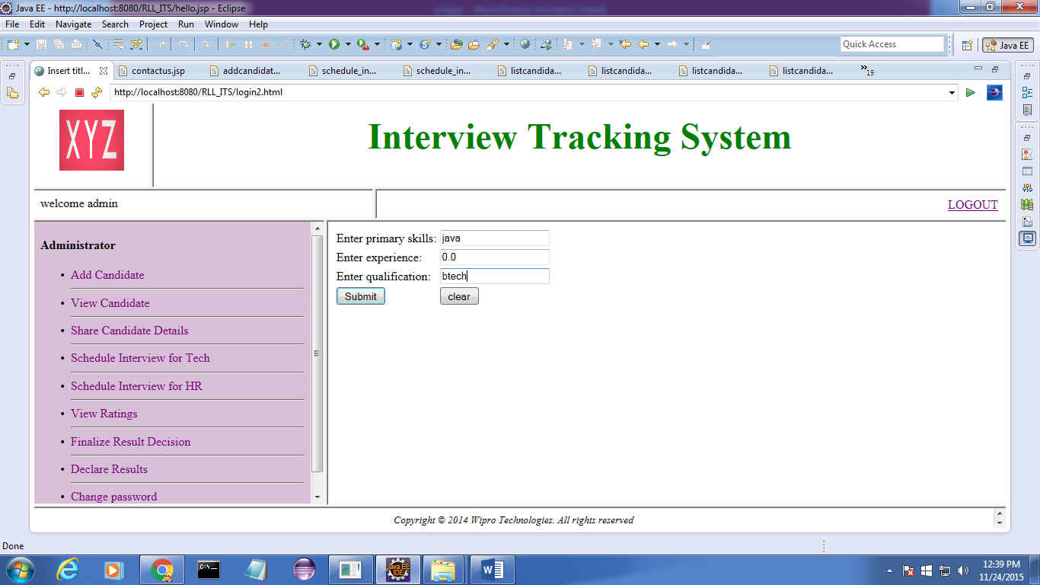
SEARCH CANDIDATE DETAILS:
List on the basis of the searched quality

Slide 17
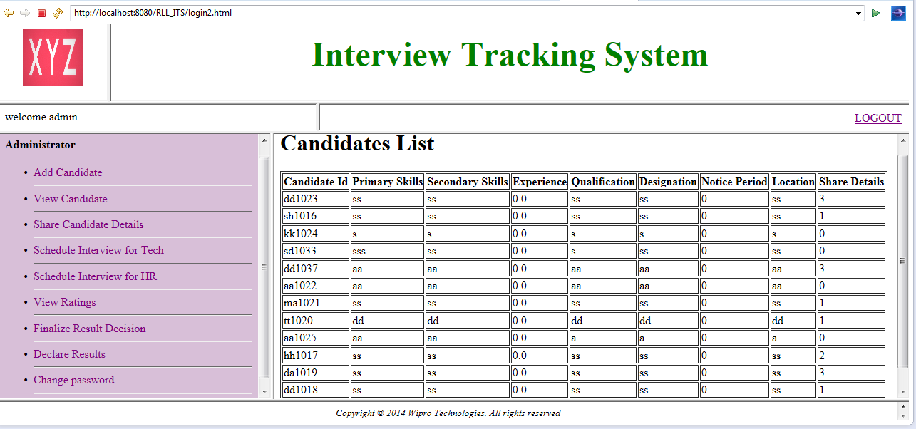
SEARCH CANDIDATE DETAILS:
LIST

Slide 18
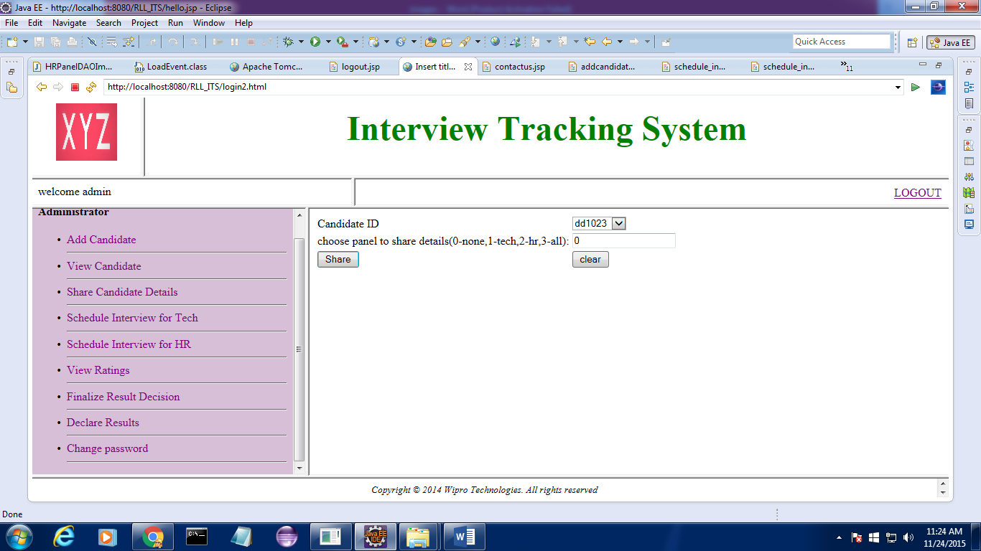
SHARE CANDIDATE DETAILS:
SHARE DETAILS

Slide 19
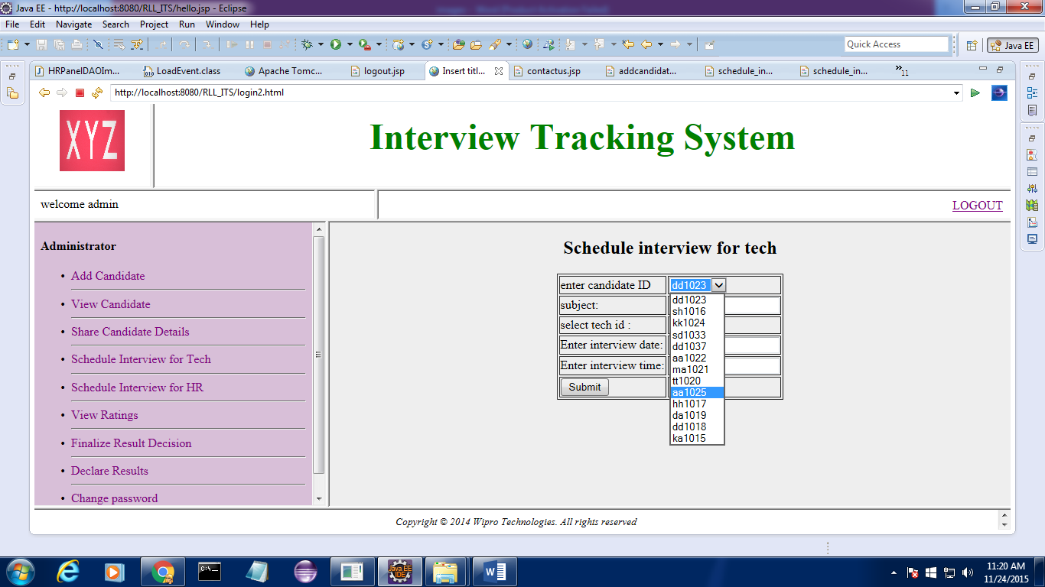
SCHEDULE INTERVIEW FOR TECH PANEL:
SCHEDULE INTERVIEW FOR TECH

Slide 20
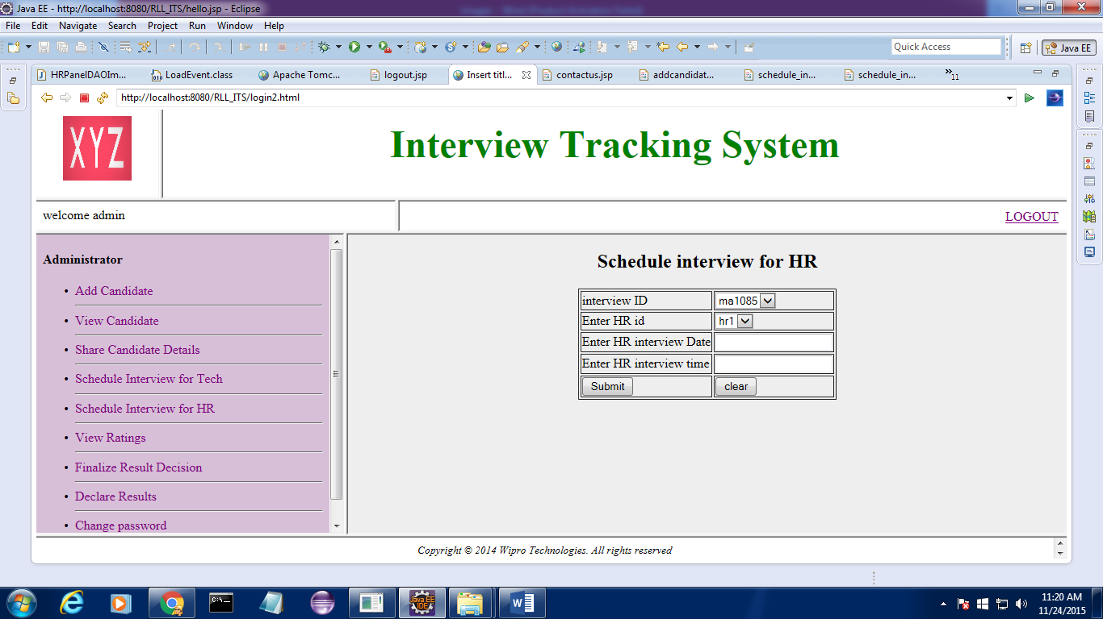
SECHEDULE INTERVIEW FOR HR PANEL:
SCHEDULE INTERVIEW FOR HR

Slide 21

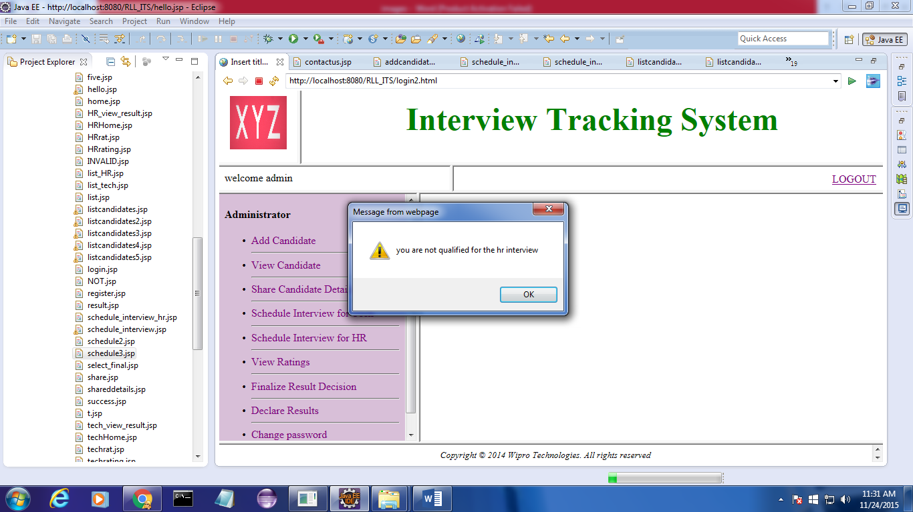
SECHEDULE INTERVIEW :
VALIDATOR

Slide 22
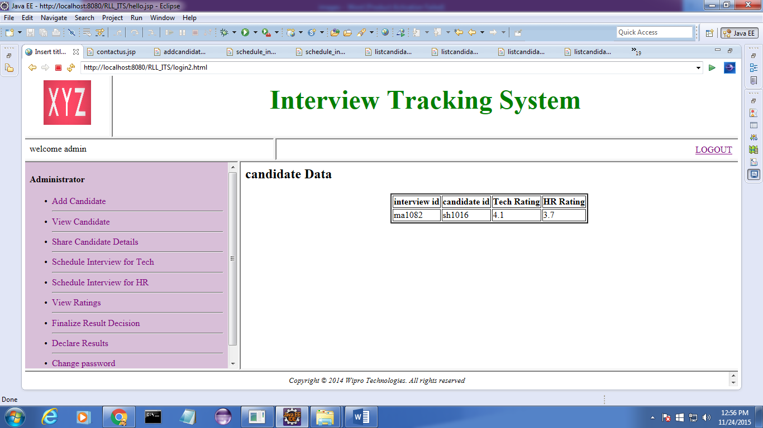
VIEW RATINGS:
CHECK RATING

Slide 23
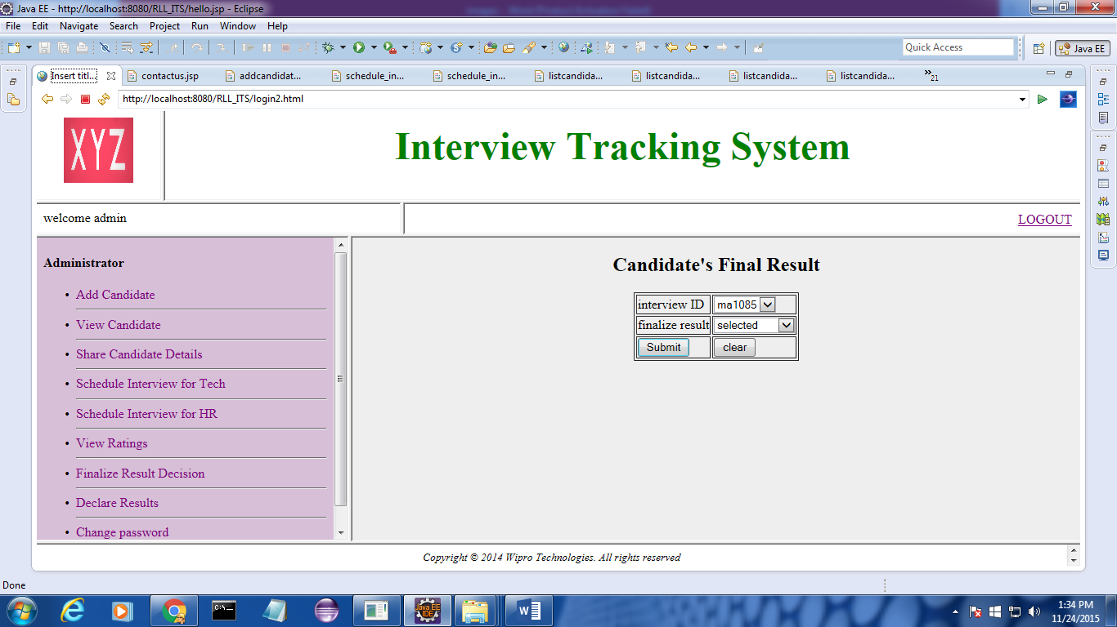
FINAL DECISION:
Final decision by admin

Slide 24
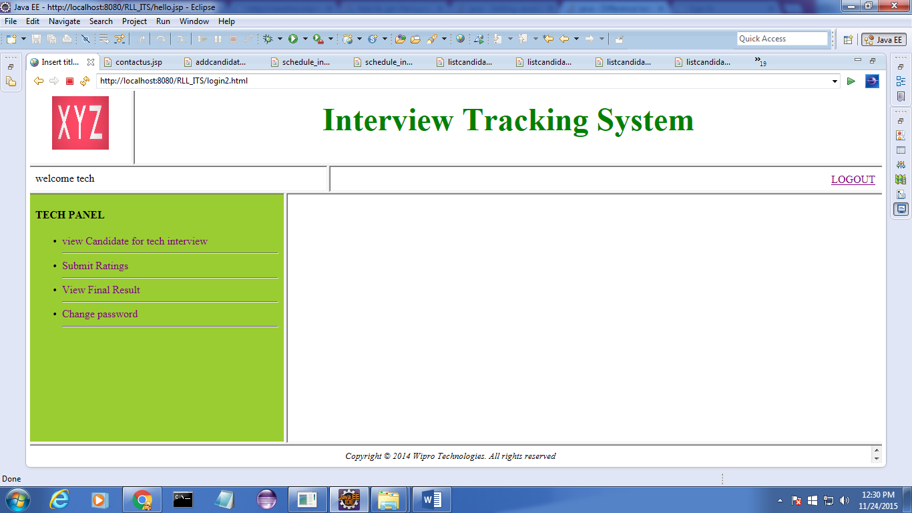
ADMIN:

Slide 25
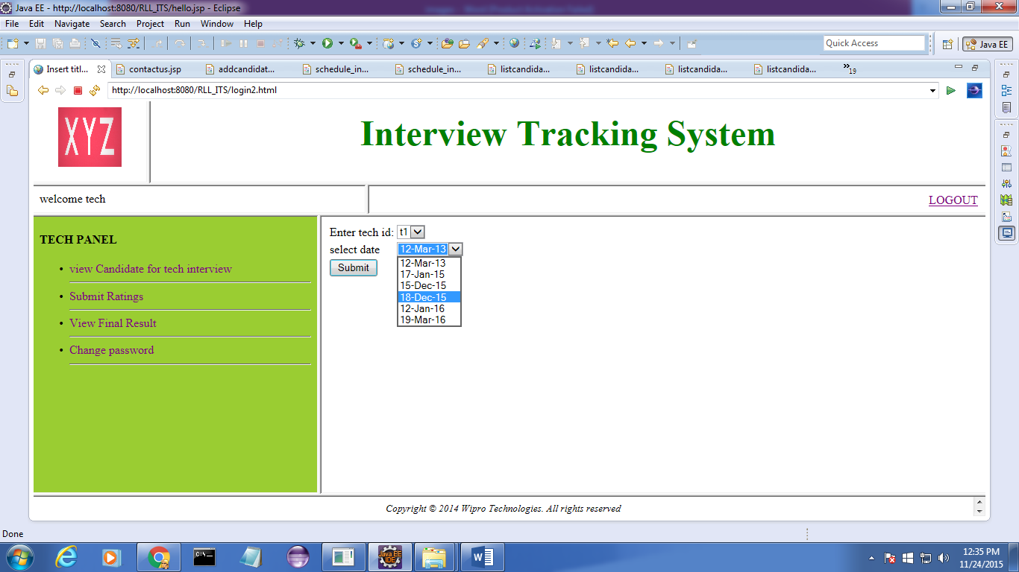
VIEW CANDIDATE DETAILS:
VIEW CANDIDATES FOR INTERVIEW

Slide 26
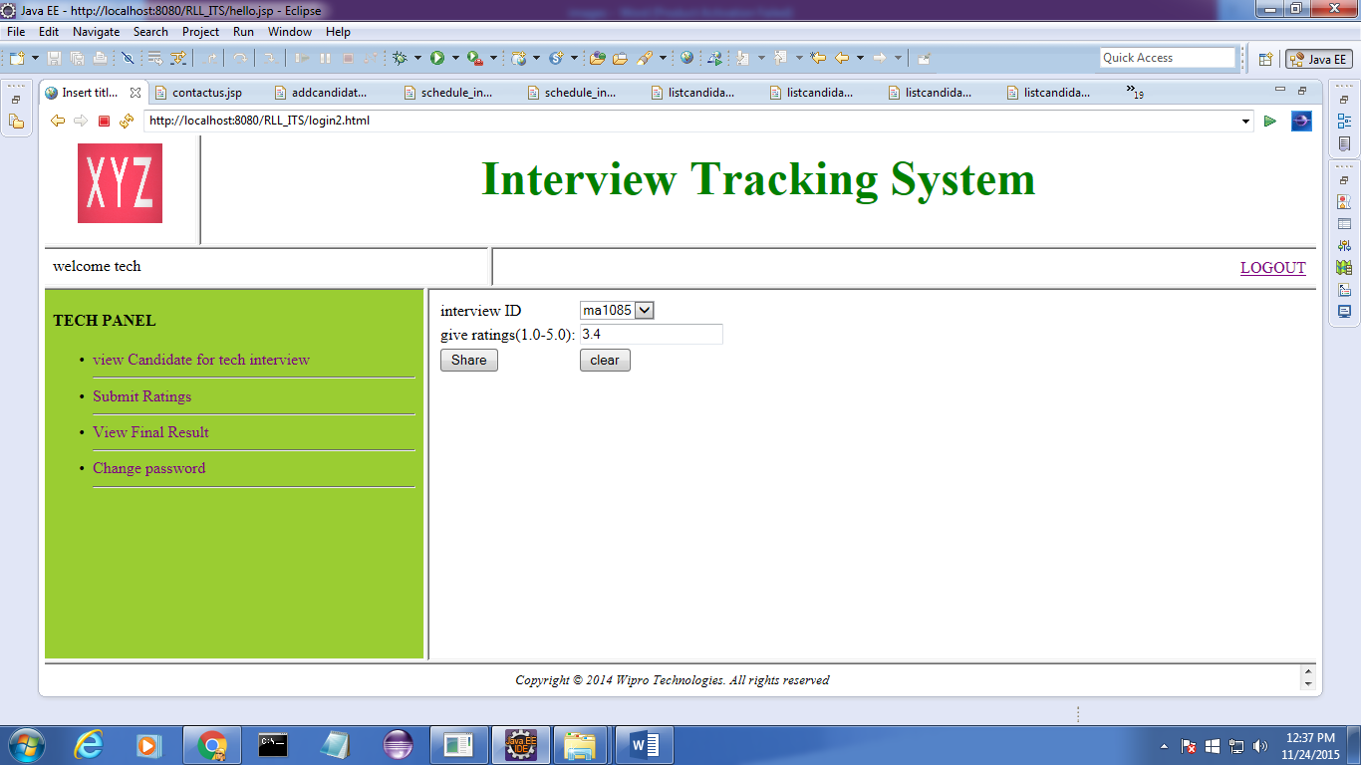
SUBMIT CANDIDATE RATINGS:
GIVE RATING

Slide 27

VIEW FINAL RESULT:
VIEW FINAL RESULT

Slide 28

VIEW FINAL RESULT:
IF RESULT IS NOT DECLARED

Slide 29
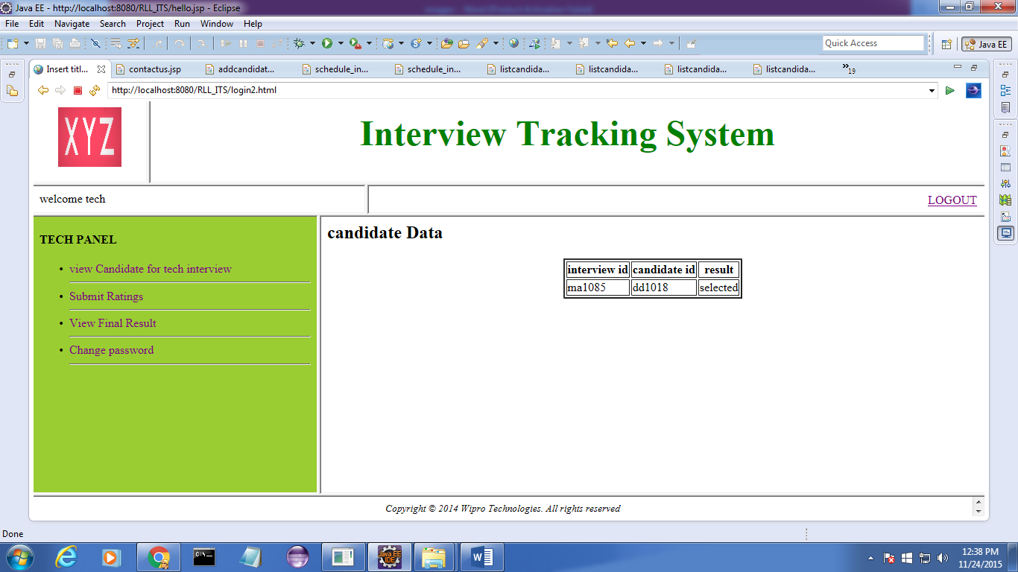
VIEW FINAL RESULT:
IF RESULT IS DECLARED

Slide 30
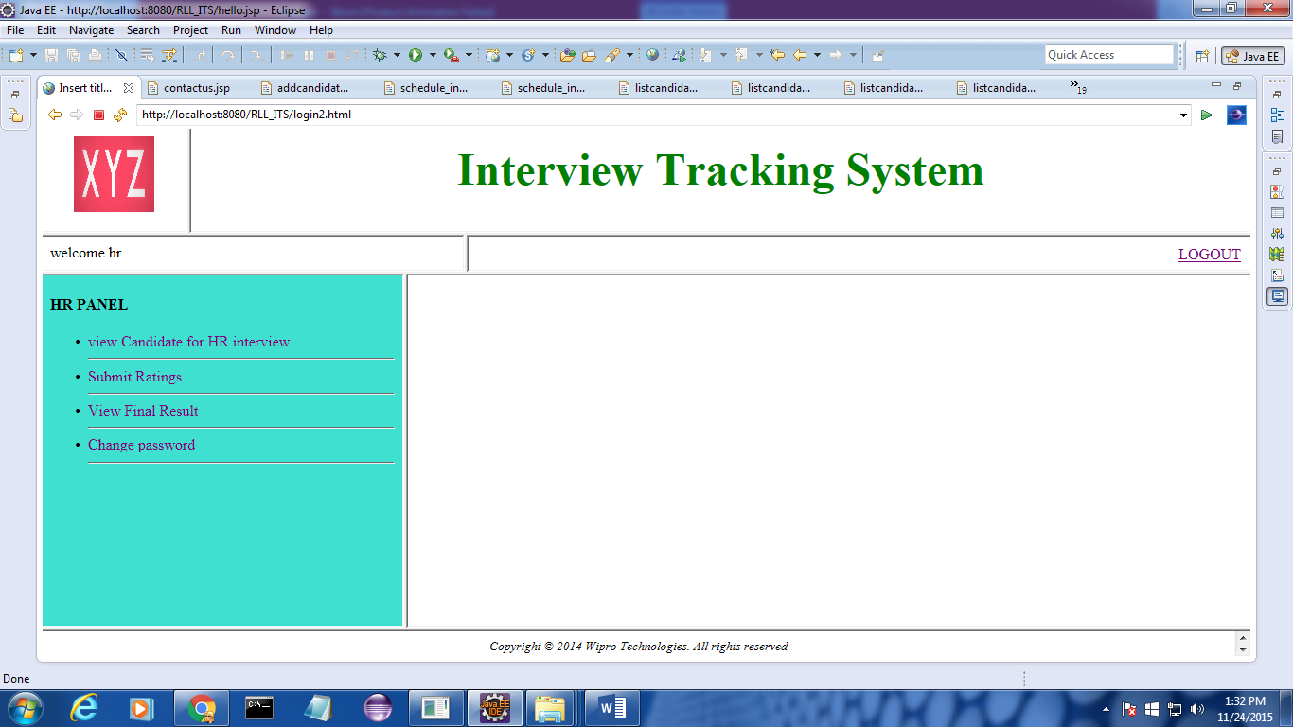
ADMIN:

Slide 31
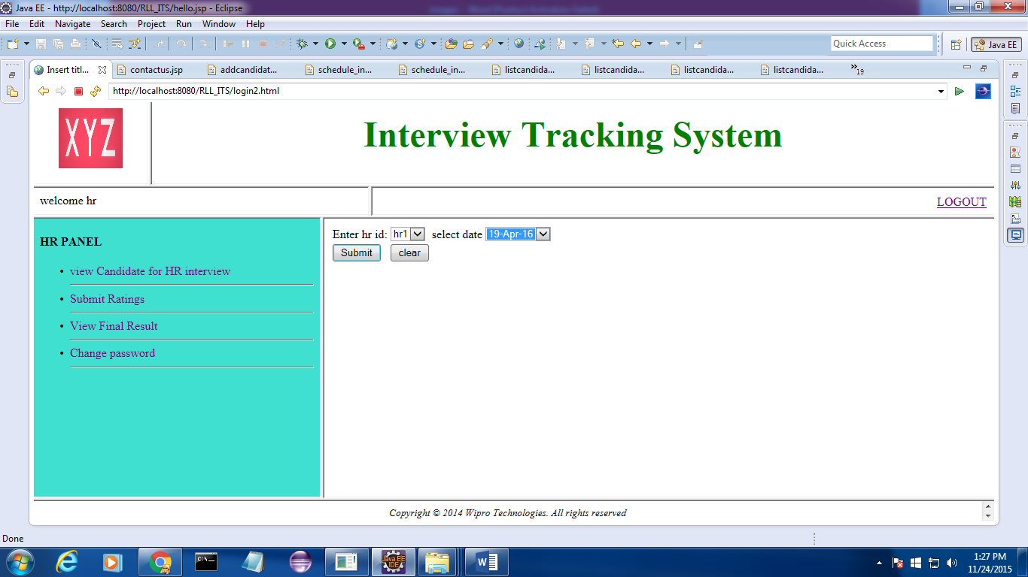
VIEW CANDIDATE DETAILS:
VIEW CANDIDATES FOR INTERVIEW

Slide 32

SUBMIT CANDIDATE RATINGS:
GIVE RATING

Slide 33

VIEW FINAL RESULT:
VIEW FINAL RESULT

Slide 34
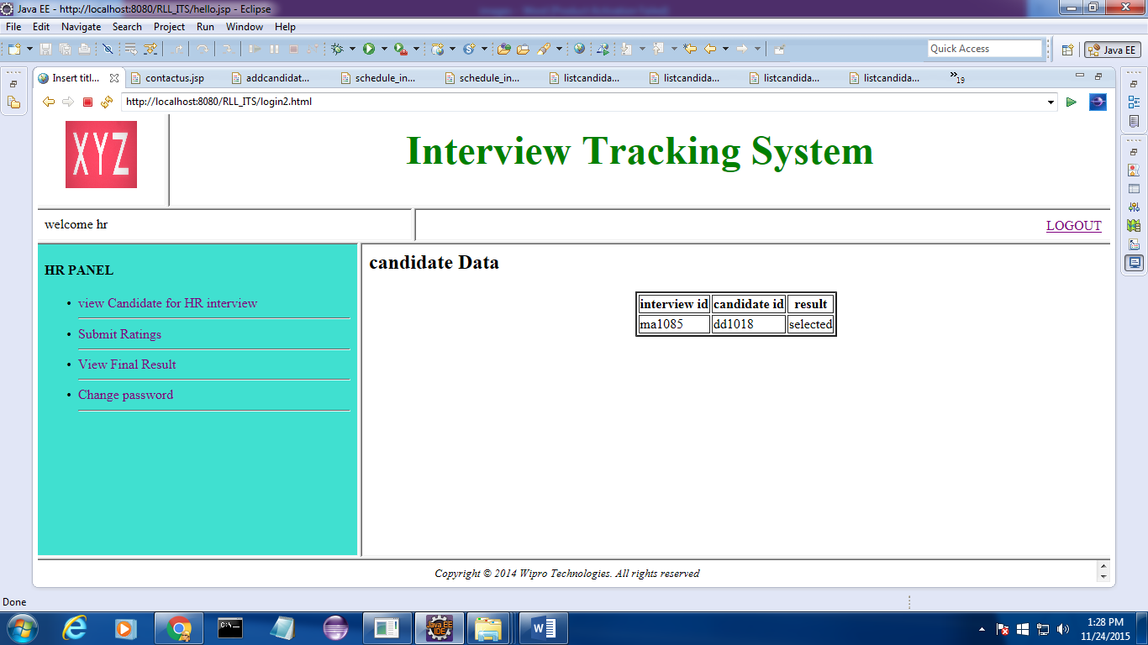
VIEW FINAL RESULT:
IF RESULT IS DECLARED

Slide 35
THANK YOU

